Slide 1
Face recognition

Slide 2
Table of contents
01
02
03
04
Introduction
Literature Review
Methodology
Results And Discussion
05
conclusion

Slide 3
01
introduction

Slide 4
introduction
Face recognition systems rely on linear algebra, specifically eigenvectors and eigenvalues, to represent and process facial images. Eigenvectors and eigenvalues help compress image data and capture essential features while reducing dimensionality.
The effectiveness of a face recognition system depends on a diverse and comprehensive database. A database should contain multiple images of each individual, capturing various facial expressions, lighting conditions, and other factors. This diversity enhances the system's ability to match and identify faces accurately.

Slide 5
02
Literature Review

Slide 6
03
Methodology

Slide 7
Methodology
The methodology of face recognition using Eigenfaces relies on linear algebra to represent and analyze facial features. It involves collecting and preprocessing a dataset of face images, computing eigenvectors and eigenvalues, selecting significant eigenvectors, projecting new faces onto these eigenvectors, and classifying them based on weights. The Eigenfaces method is computationally efficient, and capable of handling variations in lighting, and facial expression.
The step-by-step procedure for implementing the Eigenfaces method includes computing the covariance matrix, performing eigendecomposition to obtain eigenvectors and eigenvalues, and selecting a subset of eigenvectors with high eigenvalues. New face images are projected onto the selected eigenvectors to obtain weight vectors, which are compared to known faces using a distance metric for classification, such as Euclidean distance.
The Eigenfaces method's advantages lie in its computational efficiency and ability to handle variations in facial conditions. The presentation also briefly mentions other face recognition approaches, such as Local Binary Patterns, Principal Component Analysis, and Convolutional Neural Networks, noting that each approach has its own strengths and weaknesses. However, the Eigenfaces method stands out for its simplicity, accuracy, and widespread application potential.

Slide 8
04
Results And Discussion

Slide 9
Results And Discussion
The results and discussion of the face recognition algorithm using Python code and its libraries are presented. The algorithm was tested on black and white images of subjects' faces, with consistent dimensions. Errors occurred when using different dimension images if not handled properly.
The algorithm computed the ten eigenfaces with the highest eigenvalues, known as ghost faces, using the training set. The quality of the ghost faces varied depending on the database, with some appearing sharper and others blurry due to factors like background and image features.

Slide 10
Results And Discussion
Face recognition relies on linear algebra for computing face embeddings, high-dimensional vectors representing facial features. Linear algebra operations like matrix multiplication, inversion, and factorization are essential for accurate recognition.

Slide 11
04
conclusion

Slide 12
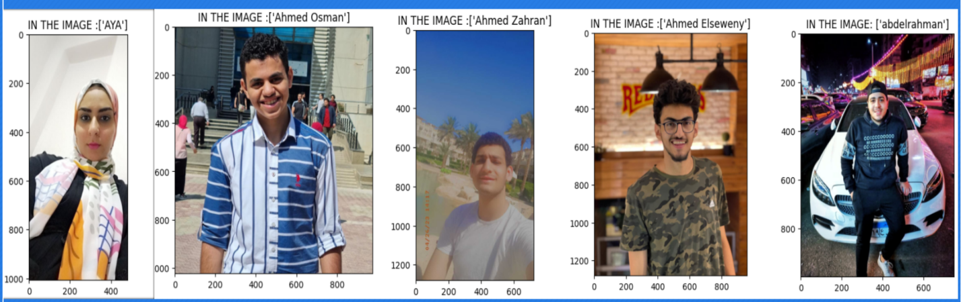
conclusion
Face recognition technology is a computer vision field that identifies and verifies individuals based on their facial features. It has applications in unlocking devices and matching faces against watch lists, among others.

Slide 13


Slide 14


Slide 15
Resources
Adjabi, I., Ouahabi, A., Benzaoui, A., & Taleb-Ahmed, A. (2020b). Past, Present, and Future of Face Recognition: A Review. Electronics, 9(8), 1188. https://doi.org/10.3390/electronics9081188.
Mu, Xiaohui ., Li, Siying ., Haipeng., Peng. (2020). A Review of Face Recognition Technology. IEEE Access. PP. 1-1. 10.1109/ACCESS.2020.3011028. https://www.researchgate.net/publication/343118558_A_Review_of_Face_Recognition_Technology
Çarıkçı, M., & Özen, F. (2012). A Face Recognition System Based on Eigenfaces Method.ProcediaTechnology,1, 118–123. https://doi.org/10.1016/j.protcy.2012.02.023
A. Kapoor and J. H. Lee, "Compositional Imitation Learning: Explaining and executing one task at a time," arXiv preprint arXiv:1811.00116, Nov. 2018. Available: https://arxiv.org/pdf/1811.00116.pdf.
+

